Slide 1
Team Ink3D Charter / Plan Review
Daniel Lain
Tim Edmonson
Shawn Simonson
Jesse Bowles

Slide 2
Organization
Role | Assigned To | Responsibility
Project Manager | Daniel Lain | Maintain Project Plan Assign Tasks to Team Turn in Deliverables Risk Manager Change Approval
Hardware Lead | Shawn Simonson | Plan Hardware Interfaces Research Hardware Hardware Development ME Liaison Change Approval
Software Engineering Lead | Jesse Bowles | System Architecture Modular Planning Scalability Planning Develop UMLs Change Approval
Lead Programmer | Tim Edmonson | Algorithm Development Open Source Selection Algorithm Research Change Approval
Oversight – Dr. Shiakolas , Mr. O’Dell
Constraints
Assumptions

Slide 3
Overview
Product Concept
Functional Requirements
User Interface Requirements
Input and Output Requirements
Packaging Requirements
Performance Requirements
Other Requirements
Uses Cases
Feasibility Analysis

Slide 4
Product Concept
Product: 3-D Printer Fabrication System
Problem Solved: The need to fabricate custom human compatible medical devices
Audience:
Dr. Panos S. Shiakolas, Manufacturing Automation and Robotic Systems (MARS) lab at University of Texas Arlington,
Medical Researchers
Material Researchers

Slide 5
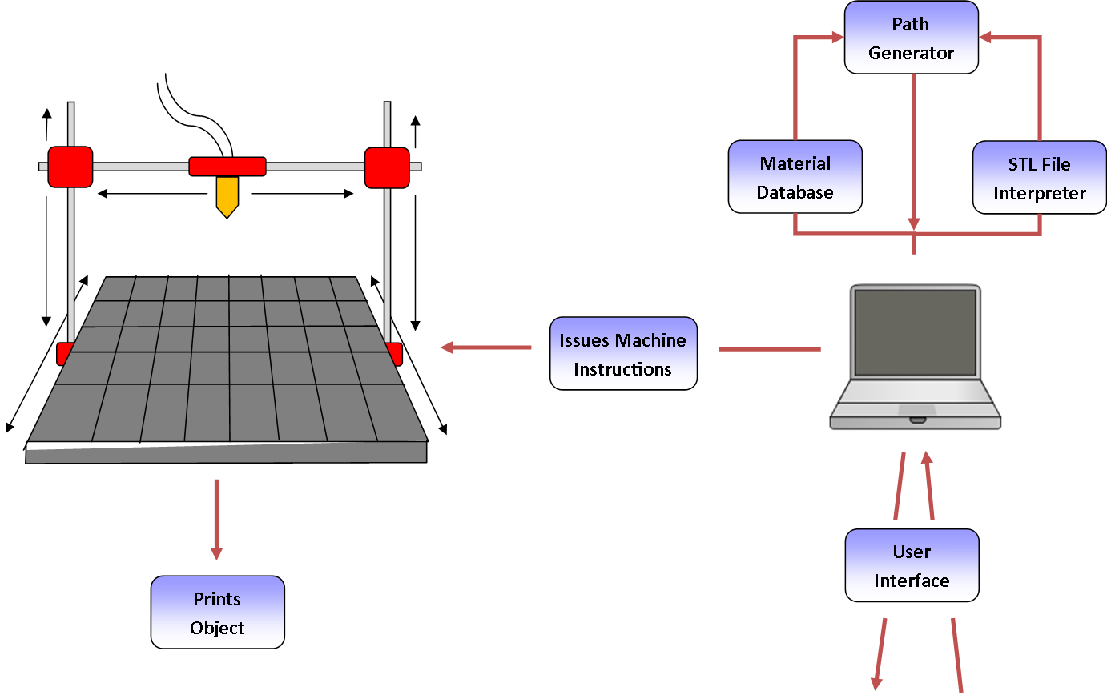
Product Concept

Slide 6
Functional Requirements
3.1 STL File Input
Priority: 1 – Critical
3.4 Issue Machine Instructions
Priority: 1 – Critical
3.5 Monitor Temperature
Priority: 1 – Critical
3.6 Monitor Position
Priority: 1 – Critical
3.8 Identify Materials
Priority: 1 - Critical
3.9 Identify Shapes
Priority: 1 - Critical
Completed
Partially Completed
Completed
Completed
Completed
Completed

Slide 7
Functional Requirements
3.10 Determine Shape of Support Material Structure
Priority: 1 - Critical
3.11 Create Printing Path
Priority: 1 – Critical
3.14 Slice Geometry into Thickness Levels
Priority: 1 – Critical
3.17 Allow for UV Head Polymerization
Priority: 1 – Critical
Non Critical Requirements
3.16 Monitor Door Switch
3.18 Sparsity and Density Controls
Completed
Completed
Completed
Completed
Incomplete
Completed

Slide 8
User Interfaces Requirements
3.2 Graphical User Interface
Priority: 3 – Moderate
3.12 Database Interface
Priority: 1 - Critical
3.13 Store & Load Material Records
Priority: 1 – Critical
3.19 Graphical Object Models
Priority: 5 – Future
Completed
Completed
Completed
Incomplete

Slide 9
Packaging Requirements
4.1 Software Installer
Priority: 1 – Critical
4.2 Host Software to Printer Connection
Priority: 1 – Critical
4.3 User Manual
Priority: 3 - Moderate
Completed
Completed
Completed

Slide 10
Performance Requirements
5.1 Startup Time
Priority: 4 – Low
5.2 STL Import Time
Priority: 4 – Low
5.3 Object Processing Time
Priority: 2 – High
5.4 GUI Responsiveness
Priority: 3 – Moderate
Completed
Completed
Completed
Completed

Slide 11
Performance Requirements
5.5 Real Time Sensor Monitoring
5.5.1 Description: The system shall monitor data from sensors in real time during operation. The sensor data must be monitored in real time to ensure proper printer functionality as well as enforce safety systems.
5.5.2 Source: Tim Edmondson (Team Member)
5.5.3 Constraints: Constant monitoring of sensors could require expensive processing and memory resources.
5.5.4 Standards: None
5.5.5 Priority: 2 – High

Slide 12
Other Requirements : Safety
6.1 Temperature Cutoff Threshold
6.1.1 Description: The system shall include a temperature cutoff threshold for the printer head. If the temperature of the printer head reaches the cutoff temperature, the system will abort the operation and shut off the heating device.
6.1.2 Source: Tim Edmondson (Team Member)
6.1.3 Constraints: The system must be able to accurately monitor the temperature of each printing head.
6.1.4 Standards: None
6.1.5 Priority: 1 – Critical
6.2 Printing Area Restrictions
6.2.1 Description: The system shall only extrude material within a configured area. Material extruded by the printer will be at a high temperature and may cause harm to the printer’s surroundings; therefore it is important to ensure that the material is only extruded in a specified safe area.
6.2.2 Source: Tim Edmondson (Team Member)
6.2.3 Constraints: None
6.2.4 Standards: None
6.2.5 Priority: 1 – Critical

Slide 13
Other Requirements: Maintenance and Support
7.1 Host Software Manual
7.1.1 Description: A manual that details the operation of the host software shall be provided. Here, “host software” is that software which is run on the workstation that generates machine instructions for the printing hardware. The manual must detail common troubleshooting issues as well as provide basic usage instructions.
7.1.2 Source: Shawn Simonson (Team Member)
7.1.3 Constraints: None
7.1.4 Standards: None
7.1.5 Priority: 1 – Critical
7.2 Source Code Documentation
7.2.1 Description: The source code developed by the software team shall be well documented with comments explaining the functionality of all modules and any non- obvious code. This documentation is intended to support any future development on the system.
7.2.2 Source: Tim Edmondson (Team Member)
7.2.3 Constraints: None
7.2.4 Standards: None
7.2.5 Priority: 2 – High

Slide 14
Other Requirements: Maintenance and Support
7.3 Source Code Availability
7.3.1 Description: The source code developed by the software team shall be freely available to developers and the public. The source code will be hosted on a public repository.
7.3.2 Source: Shawn Simonson (Team Members)
7.3.3 Constraints: None
7.3.4 Standards: Git, SVN
7.3.5 Priority: 2 – High

Slide 15
Other Requirements: Additional
8.1 Material Database
8.1.1 Description: The system shall have a database that holds information about how the material is printed. For each material, the database must hold the diameter of the material filament and the temperature the filament must be extruded at.
8.1.2 Source: Dr. Panos S. Shiakolas (Sponsor)
8.1.3 Constraints: None
8.1.4 Standards: Binary Text
8.1.5 Priority: 1 – Critical
8.2 Abstract Hardware Interface
8.2.1 Description: The system shall allow for multiple different printers and multiple different heads to be used with minimal software change.
8.2.2 Source: Jesse Bowles (Team Member)
8.2.3 Constraints: Unknown hardware interface
8.2.4 Standards: None
8.2.5 Priority: 1 – Critical

Slide 16
Other Requirements: Additional
8.3 Modular and Scalable Design
8.3.1 Description: The software shall be developed using proven design principles to ensure that it can be scaled and maintained by future development teams.
8.3.2 Source: Dr. Panos S. Shiakolas (Sponsor)
8.3.3 Constraints: None
8.3.4 Standards: S.O.L.I.D. Design Principles
8.3.5 Priority: 1 – Critical

